Slide 1

Database Management Systems
Shamim Ahmad

Slide 2
Entity and Attribute

Slide 3
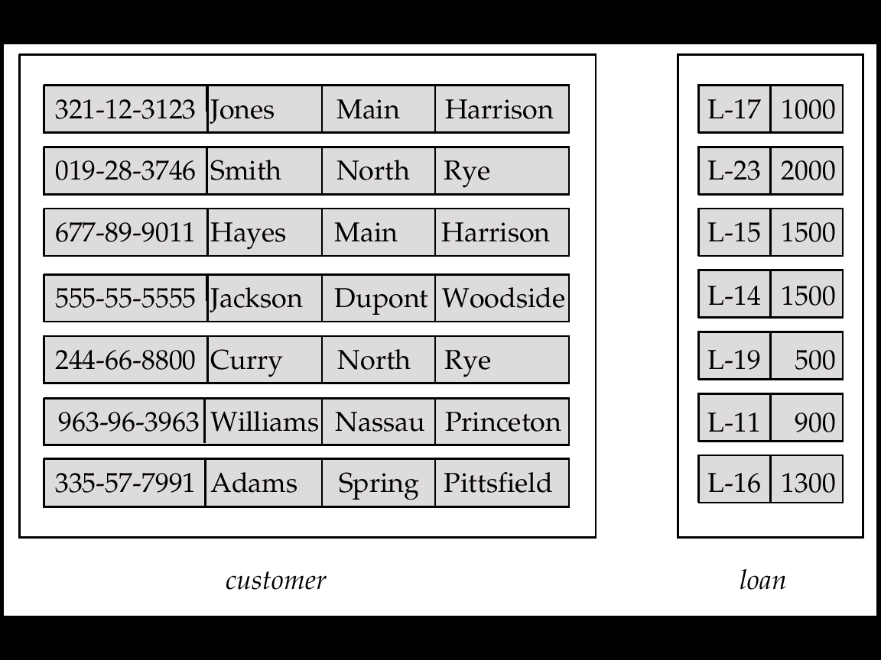

Entity Sets customer and loan
customer-id customer- customer- customer- loan- amount name street city number

Slide 4
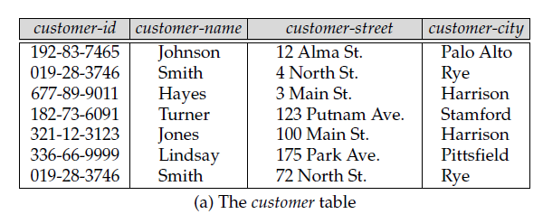
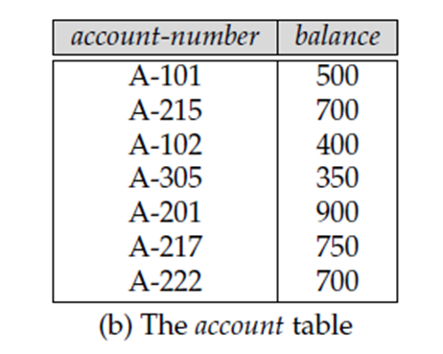

Slide 5
Basic Concepts (Cont.)
Relationship Sets
A relationship is an association among several entities
Example: Hayes depositor A-102 customer entity relationship set account entity
A relationship set is a mathematical relation among n ≥ 2 entities, each taken from entity sets
{(e₁, e₂, … e_{n}) | e₁ ∈ E₁, e₂ ∈ E₂, …, e_{n} ∈ E_{n}} where (e₁, e₂, …, e_{n}) is a relationship

Slide 6
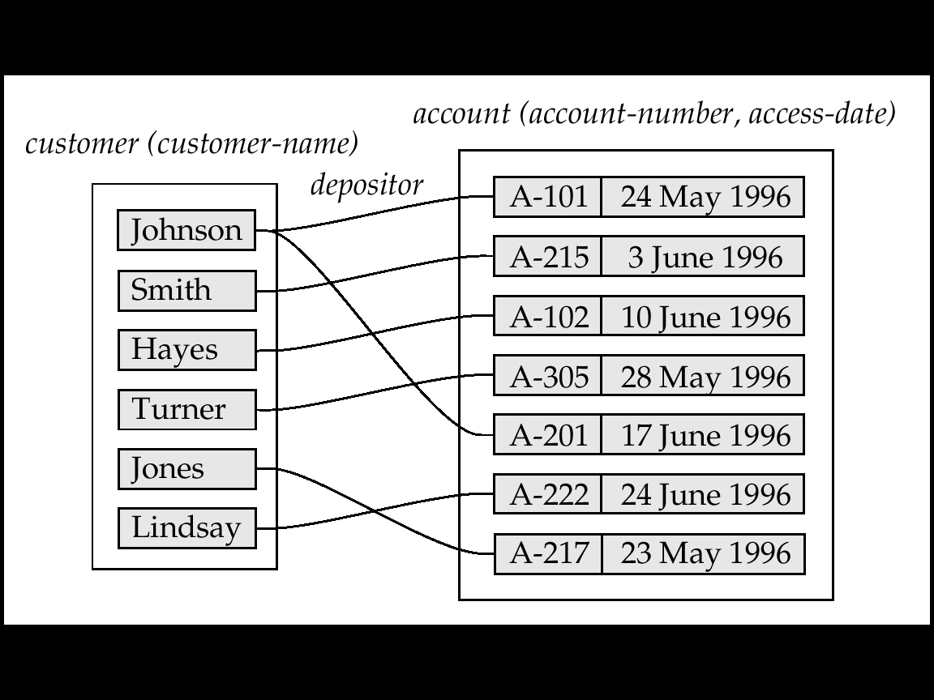
Example: (Hayes, A-102) ∈ depositor

Slide 7
Example: (Hayes, A-102) ∈ depositor

Slide 8
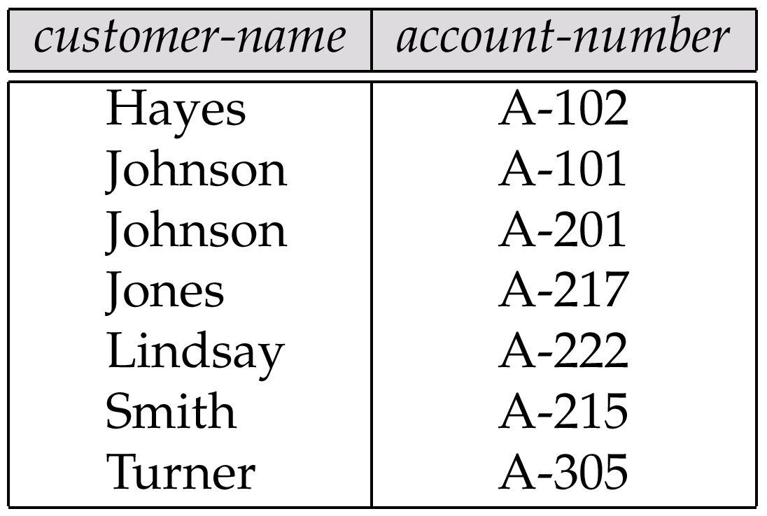
The depositor Relation

Slide 9
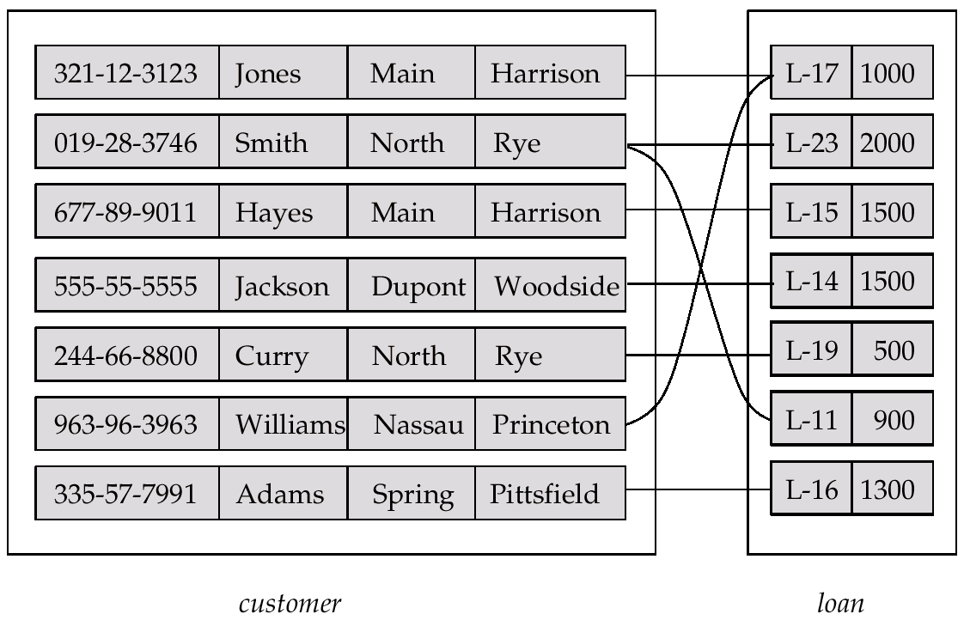
Relationship Set borrower

Slide 10
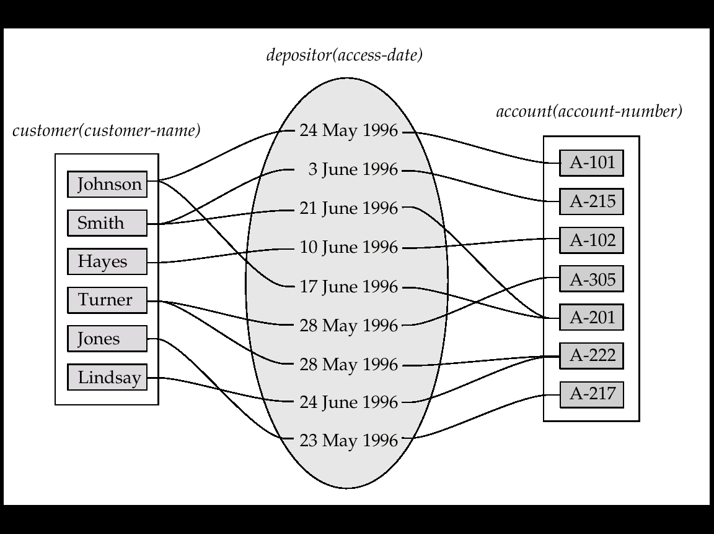
Basic Concepts(Cont.)
An attribute can also be property of a relationship set.
For instance, the depositor relationship set between entity sets customer and account may have the attribute access-date

Slide 11
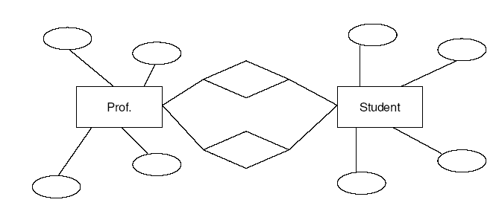
Role: Recursive Relationship
Manager
Employee
Employee
Worker
A relationship Set
works-for
that is modeled by
ordered pairs of employee entities

Slide 12
Basic Concepts(Cont.)
Degree of a Relationship Set
Refers to number of entity sets that participate in a relationship set.
Relationship sets that involve two entity sets are binary (or degree two). Generally, most relationship sets in a database system are binary.
Relationship sets may involve more than two entity sets.
Relationships between more than two entity sets are rare. Most relationships are binary. (More on this later.)
E.g. Suppose employees of a bank may have jobs (responsibilities) at multiple branches, with different jobs at different branches. Then there is a ternary relationship set between entity sets employee, job and branch

Slide 13
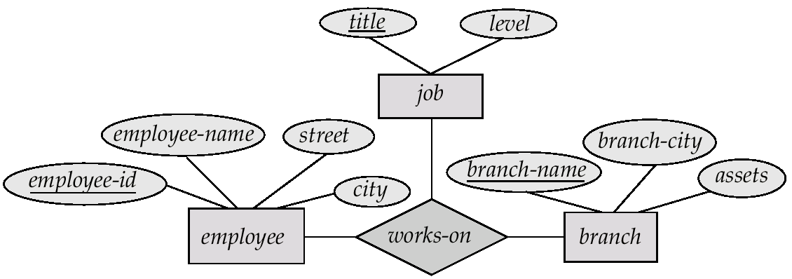
E-R Diagram with a Ternary Relationship

Slide 14
Constraints
Mapping Cardinalities
Express the number of entities to which another entity can be associated via a relationship set.
Most useful in describing binary relationship sets.
For a binary relationship set the mapping cardinality must be one of the following types:
One to one
One to many
Many to one
Many to many

Slide 15
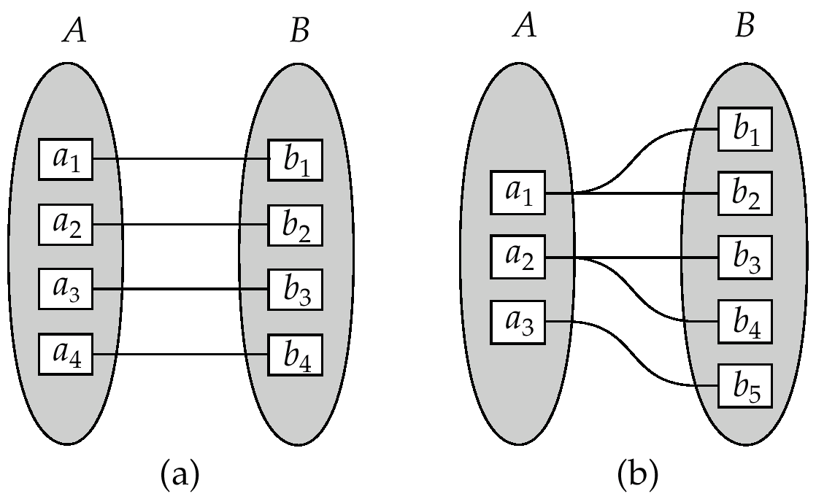
Constraints (Cont.)
One to one
One to many
Note: Some elements in A and B may not be mapped to any
elements in the other set

Slide 16
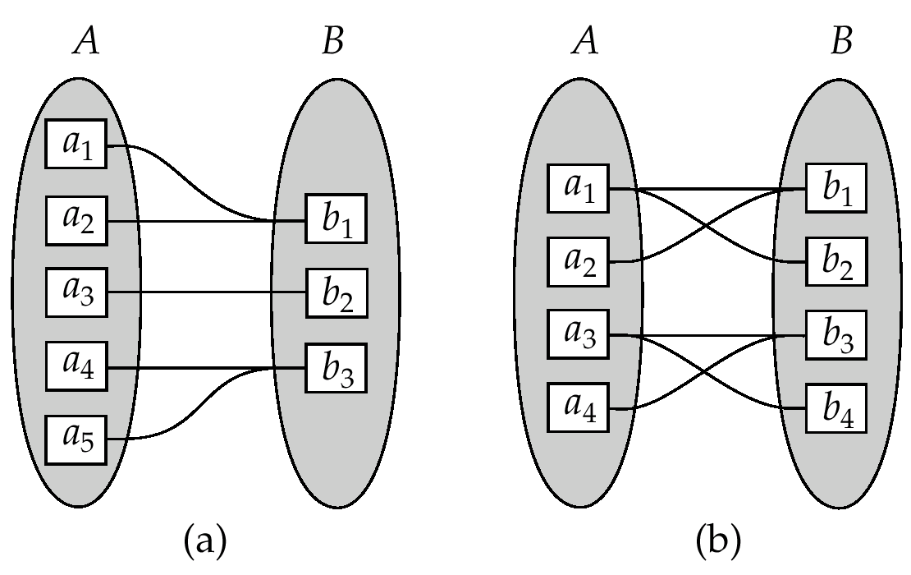
Constraints (Cont.)
Many to one
Many to many
Note: Some elements in A and B may not be mapped to any
elements in the other set

Slide 17
Constraints (Cont.)
Participation Constraints
The participation of an entity set E in a relationship set R is said to be total if every entity in E participates in at least one relationship in R.
For example, we expect every loan entity to be related to at least one customer through the borrower relationship.
If only some entities in E participate in relationship in R, the participation of entity set E in relationship R is said to be partial.
For example, the participation of customer in the borrower relationship set is therefore set is therefore partial.
চিহ্ণতকরণকে
চিহ্ণতকরণকে

Slide 18
Keys
Entity Sets
A super key of an entity set is a set of one or more attributes whose values uniquely determine each entity.
A candidate key of an entity set is a minimal super key
Customer-id is candidate key of customer
account-number is candidate key of account
Although several candidate keys may exist, one of the candidate keys is selected to be the primary key.

Slide 19
Relationship Sets
The combination of primary keys of the participating entity sets forms a super key of a relationship set.
primary-key(E1) ∪ primary-key(E2) ∪ · · · ∪ primary-key(En)
describes an individual relationship in set R.
primary-key(E1) ∪ primary-key(E2) ∪ · · · ∪ primary-key(En) ∪ {a1, a2, . . . , am}

Slide 20
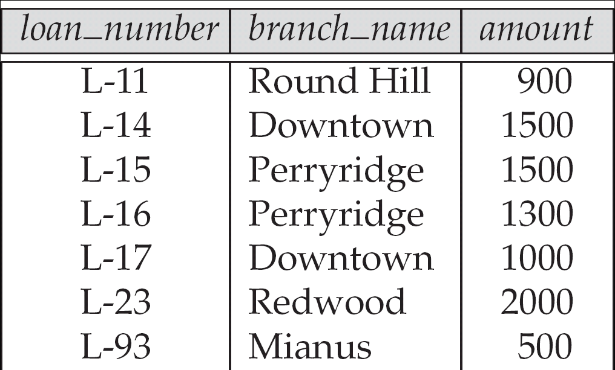
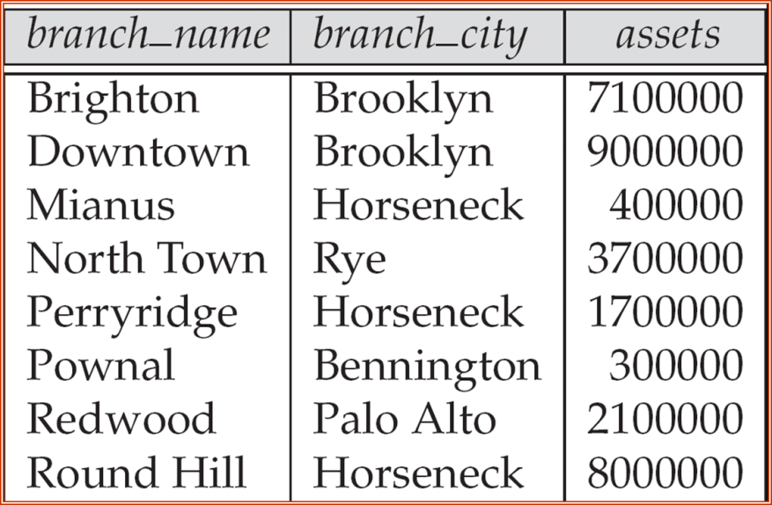

The loan relation

Slide 21

Binary Relationships
If there are two entity types involved it is a binary relationship type

Slide 22

Ternary relationship
If there are three entity types involved it is a ternary relationship type

Slide 23
Replacing ternary relationships
When ternary relationships occurs in an ER model they should always be removed before finishing the model.
Sometimes the relationships can be replaced by a series of binary relationships that link pairs of the original ternary relationship.

Slide 24

Replacing ternary relationships (Cont)
Relationships are usually verbs, so name the new entity type by the relationship verb rewritten as a noun.
The relationship sells can become the entity type sale.
So a sales assistant can be linked to a specific customer and both of them to the sale of a particular product.
This process also works for higher order relationships.

Slide 25
E-R Diagrams
Rectangles represent entity sets.
Diamonds represent relationship sets.
Lines link attributes to entity sets and entity sets to relationship sets.
Ellipses represent attributes
Double ellipses represent multivalued attributes.
Dashed ellipses denote derived attributes.
Underline indicates primary key attributes

Slide 26
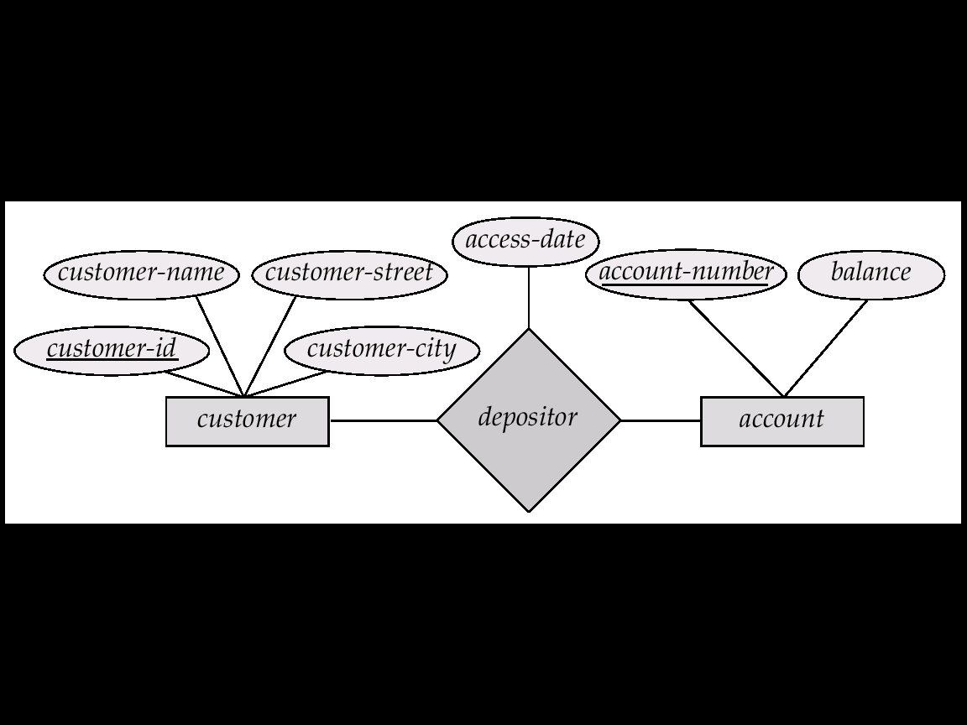
Relationship Sets with Attributes

Slide 27
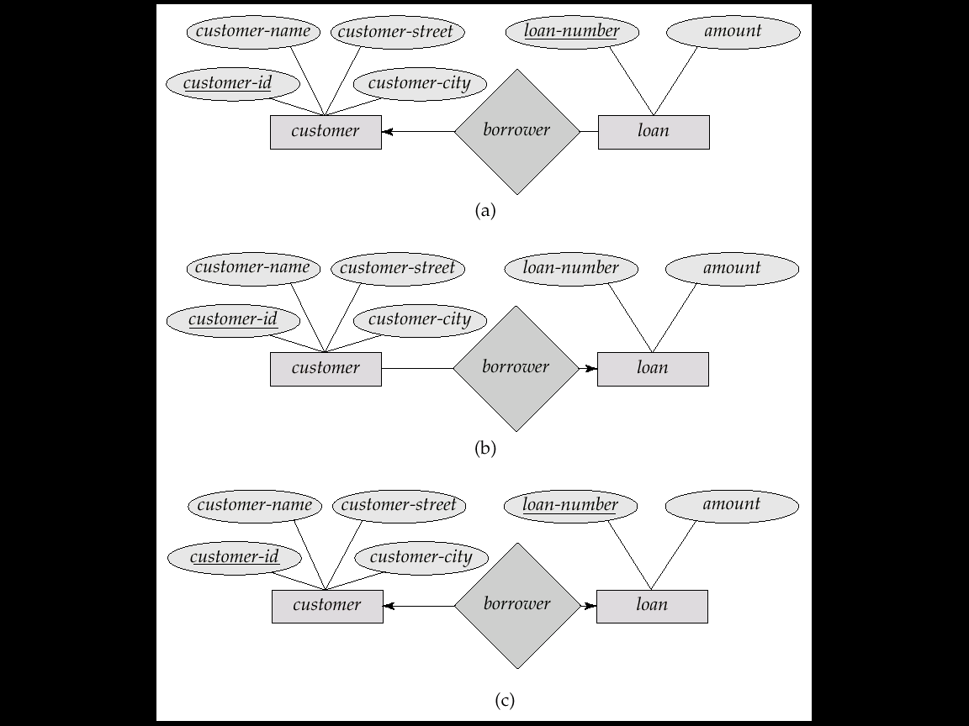
Cardinality Constraints
We express cardinality constraints by drawing either a directed line (→), signifying “one,” or an undirected line (—), signifying “many,” between the relationship set and the entity set.
E.g.: One-to-one relationship:
A customer is associated with at most one loan via the relationship borrower
A loan is associated with at most one customer via borrower

Slide 28

One-To-One Relationship
A man can only marry one woman, and a woman can only marry one man, so it is a one to one (1:1) relationship

Slide 29
One-To-Many Relationship
In the one-to-many relationship a loan is associated with at most one customer via borrower, a customer is associated with several (including 0) loans via borrower

Slide 30

One-To-Many Relationship
One manager manages many employees, but each employee only has one manager, so it is a one to many (1:n) relationship

Slide 31
Many-To-One Relationships
In a many-to-one relationship a loan is associated with several (including 0) customers via borrower, a customer is associated with at most one loan via borrower

Slide 32

Many-To-One Relationships
many students study one course. They do not study more than one course, so it is a many to one (m:1) relationship

Slide 33
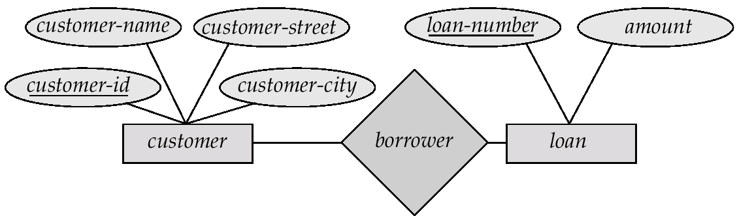
Many-To-Many Relationship
A customer is associated with several (possibly 0) loans via borrower
A loan is associated with several (possibly 0) customers via borrower

Slide 34

Many-To-Many Relationship
One lecturer teaches many students and a student is taught by many lecturers, so it is a many to many (m:n) relationship

Slide 35
Deriving the relationship parameters
To check we have the correct parameters (sometimes also known as the degree) of a relationship, ask two questions:
One course is studied by how many students? Answer = `zero or more'
This gives us the degree at the `student' end
The `more' part means that the cardinality is `many
The `zero' part means that the relationship is `optional'. (denoted y ‘O”
If the answer was `one or more', then the relationship would be `mandatory'.
One student studies how many courses? Answer = `One'
This gives us the degree at the `course' end of the relationship.
The answer `one' means that the cardinality of this relationship is 1, and is `mandatory'

